Slide 1
ECE 143 Final Project: Financial Career Consulting Group 4: Arik Horodniceanu, Chi Zhang, Changhao Shi

Slide 2
Overview
Motivation and Objective
Data
Analysis
Conclusions
Suggestions for Further Research

Slide 3

Motivation and Objective
Choosing a career is a significant decision in one’s life:
What should I study? Which area should I go to school in? Are private or public school better?
Our approach is financially driven: The best choice is the most profitable one.
We answer the 3 above questions and determine the optimal decisions.

Slide 4
Data
We used the Kaggle database “Where it pays to attend college”. Also added specific information manually.
Dataset contained information from 270 universities and 50 undergraduate majors in 2 CSV files.
All code was ran using Python 3.6 and 3.7 and its libraries Numpy, Matplotlib, Pandas and Seaborn.

Slide 5
Analysis
Which profession should you choose?
Where should you study?
What type of school is best?

Slide 6
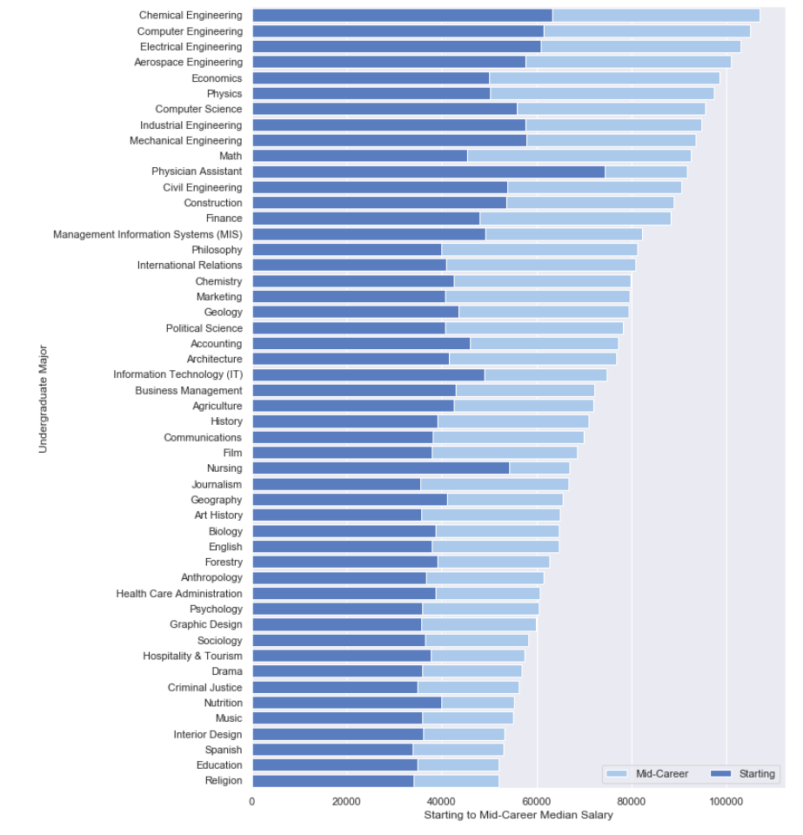
Which profession should you choose?
8/10 top median starting salaries are Engineering. Other 2 are medicine related.
7/10 top median mid-career salaries are Engineering. Other 3 also STEM.

Slide 7
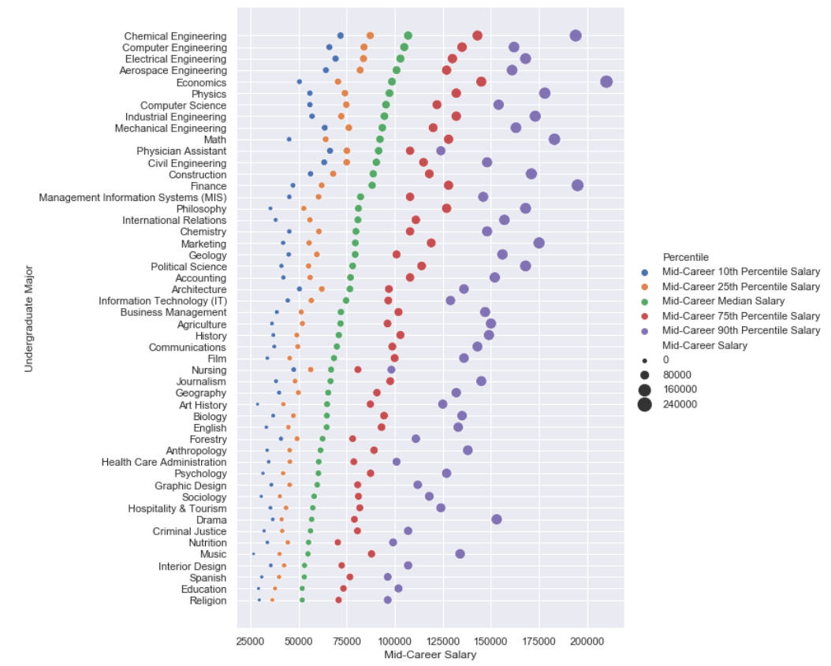
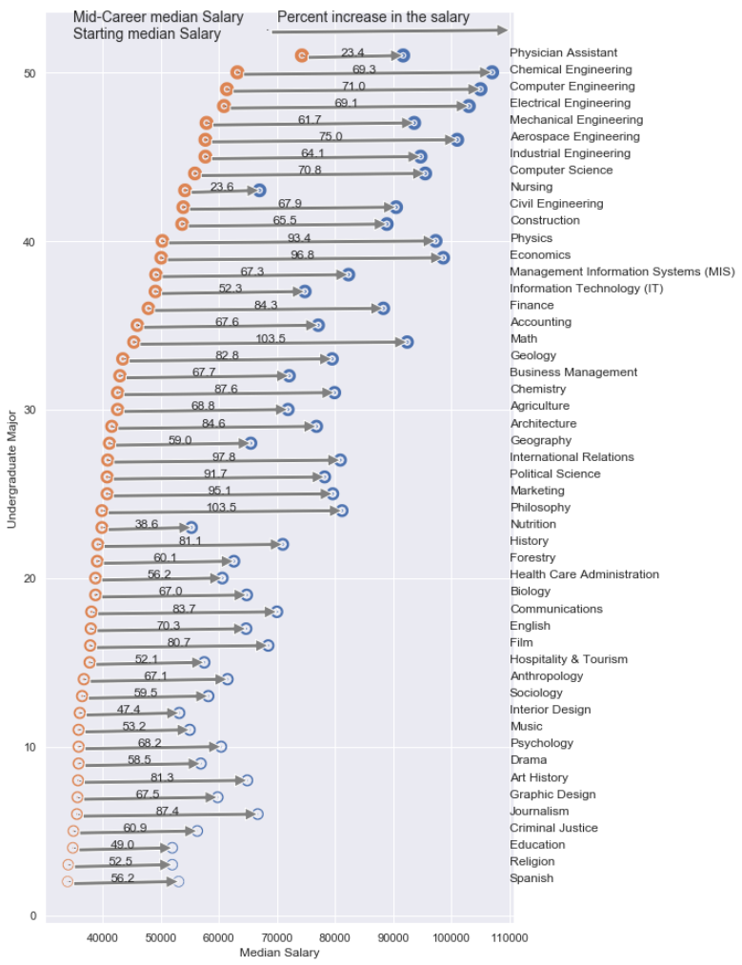

Slide 8

Conclusion
Engineering is the most profitable career choice.
Want to make the most money right out of school? Physician Assistant is best. Doesn’t increase as much over the years though.
Can’t go wrong with any STEM choice.
If you’re exceptionally talented at anything, you’ll be fine. But better to be a great engineer than a great anthropologist.
Don’t like math or medicine?

Slide 9
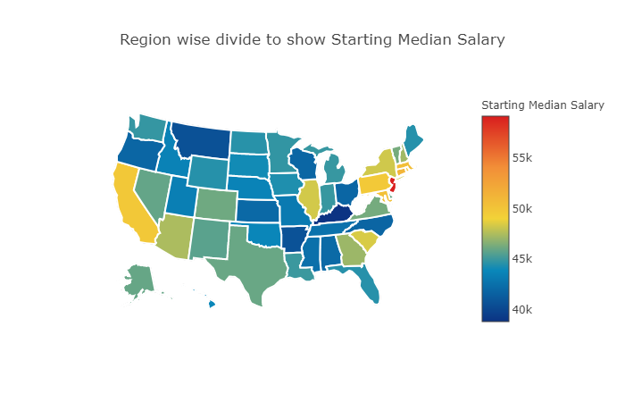
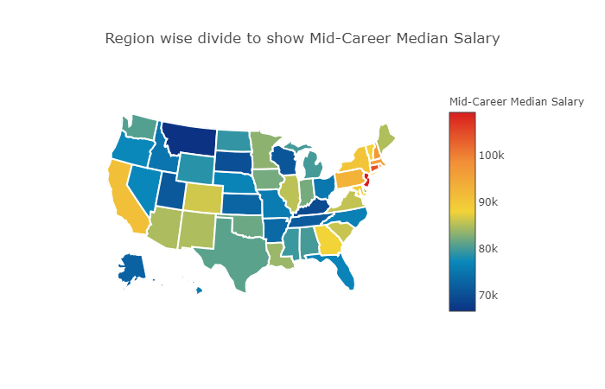
Where should you study?

Slide 10

Looking for good weather on the West Coast? Look no further than California.
More of a rain person? The East Coast is for you: New York or Massachusetts.
Anywhere in between? Not the best choice.

Slide 11
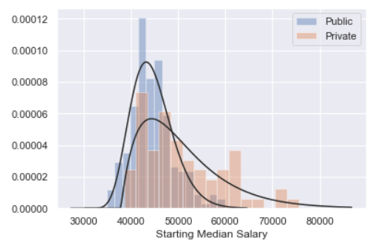
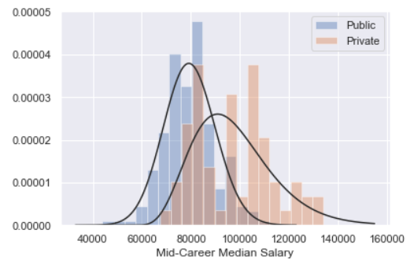
What type of school is best?
We checked 2 metrics: Salary and Return on Investment:
ROI= (Gain- Cost)/Cost.

Slide 12
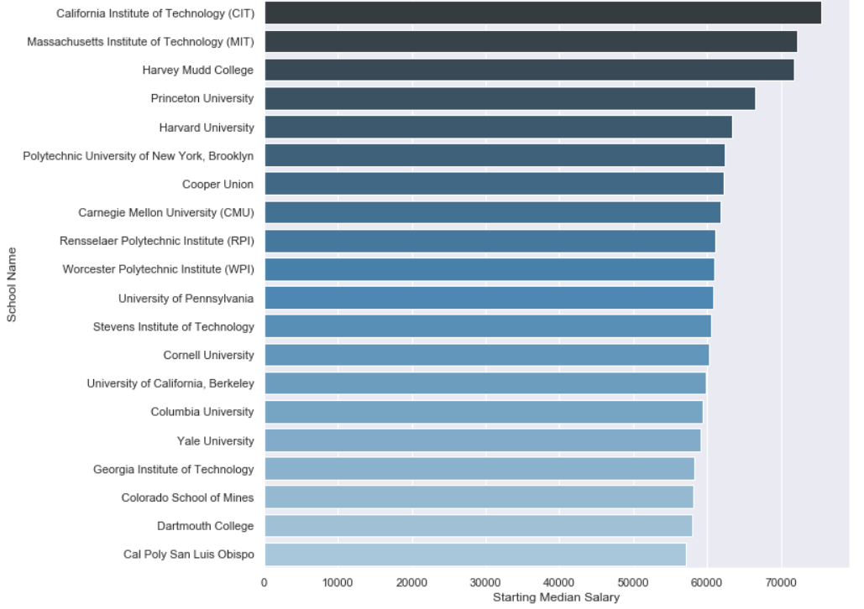
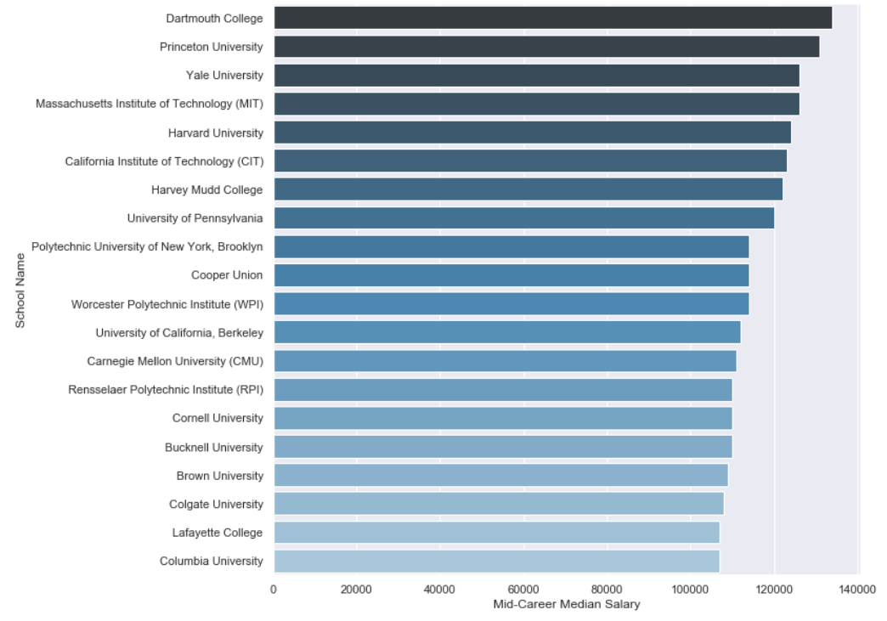

Slide 13
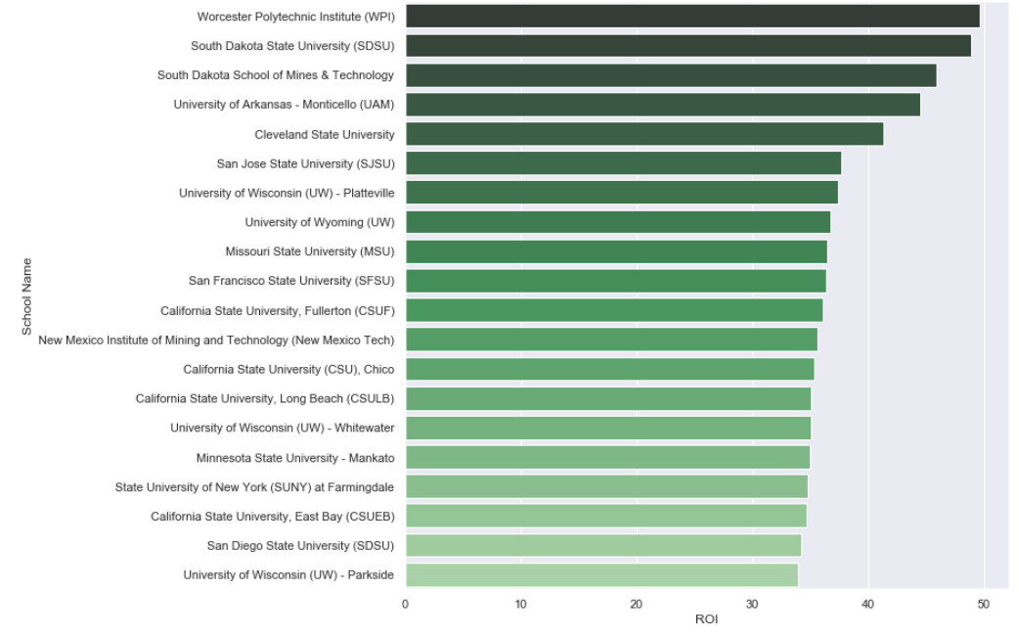

Slide 14

Top 20 best ROI schools are public schools. Get best return at state schools, preferably in California or New York.
19\20 highest salaries are from private schools. Best choices are Ivy League schools.

Slide 15
Final Conclusions
Good idea to be an Engineer. Better idea to be a great engineer.
East coast or West coast doesn’t make much difference. Depends more on personal preference.
Have the money to spend? Spend it on a good education. Don’t have enough for private schools? State schools offer great value.

Slide 16
Suggestions for further research
Effect of graduate studies on salaries.
Ranking based on weighted average of ROI, salaries or other metrics.
Connection between salaries and success in specific courses.
Good grade in ECE 143=$$$?
Many more.

Slide 17
THANK YOU
Any questions?

